Slide 1

Extending the MOC-UI
Thomas Hsu, Bill Vangos, Alex Wong, Hang Xu
Project Mentor: Jon Bell

Slide 2
MOC-UI Recap
A user interface for the Massachusetts Open Cloud, a collaboration between universities in the Boston area.
We seek to develop a dynamic marketplace and provide a friendlier user experience than the Horizon UI

Slide 3
Where We Left Off
Switched over to new UI
User management
Add/Delete
Project management
Add/Delete
Assign Roles

Slide 4
This Sprint: Focusing on Marketplace
Created and initialized database to manage projects/services.
Converted dictionary of services, ‘dicts.py’ into .json fixture for database.
Modified ‘views’ code to query the new database for services

Slide 5
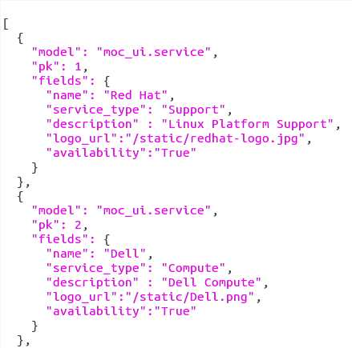
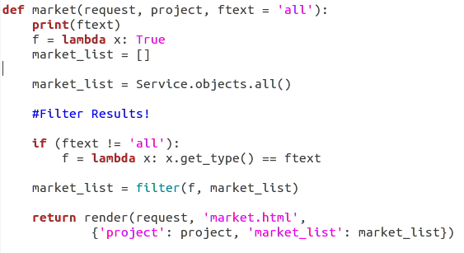
service_list.json
Django Database Querying

Slide 6
This Sprint (cont)
Explored how to filter queries in Django.
Implemented filter into marketplace sidebar.
Cleaned up broken links and unnecessary button features.

Slide 7
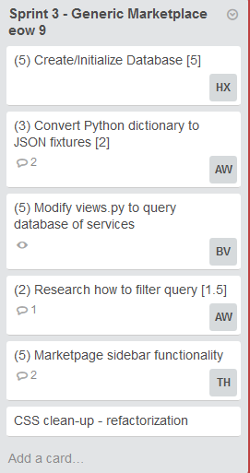
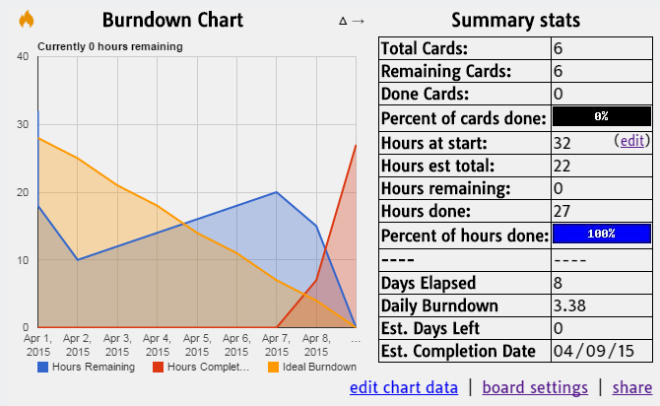
Burn Down

Slide 8
Demo

Slide 9
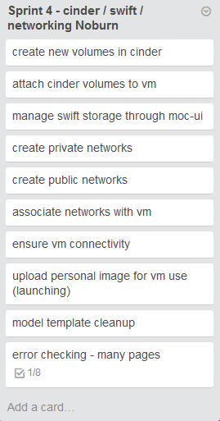
Future Plan
Main Tasks:
Add new services
to marketplace
Associate services
with Users & Project
To be discussed this weekend

Slide 10
Thanks

